Slide 1

ELEGANT OBJECT
By Yegor Bugayenko

Slide 2
Oriented Object Programming
-OOP are based one two things: codes (or methods) and bases (or attributes).
-Opposition with procedural programming

Slide 3
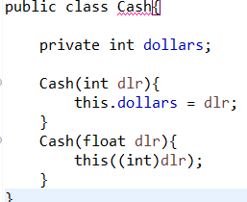
Name and constructor
-First we have to name the object by they are and not by their functions.
-Must avoid –er suffix
-Here, we have the example of a cash converter. Distinguish the primary constructor and secondaries constructors.

Slide 4
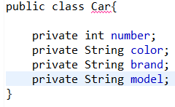
Encapsulation/Methods
-In one class, we can put 1 up to 4 objects.
Limited for the clarity.
-Use interface for public methods instead of static methods.
-Use micro classes instead of global constants.

